Slide 1
Master Data Management
in R/tidyverse
Introduction to Wrangling, Methods, & Pipeline Benefits
December 15, 2016

Slide 2
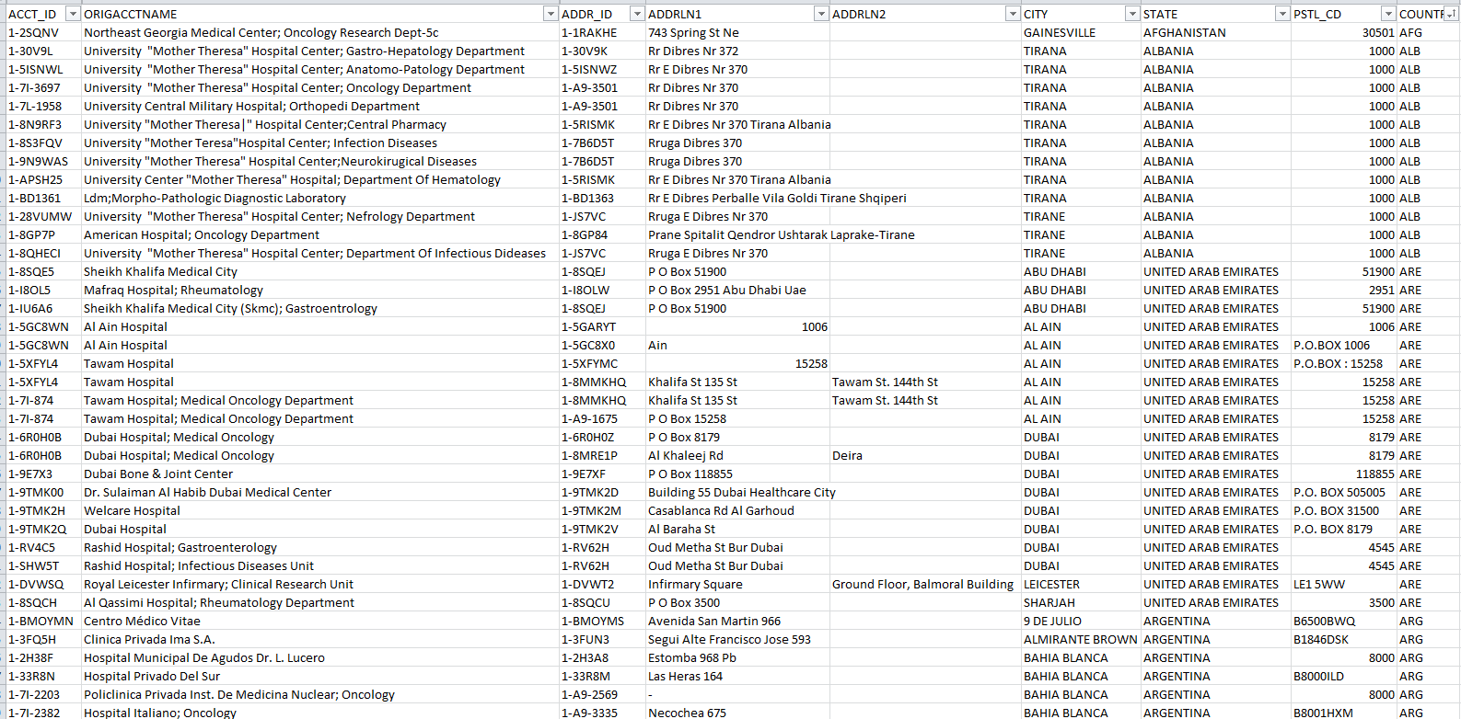
Clinical Trials Site Name and Address Data

Slide 3
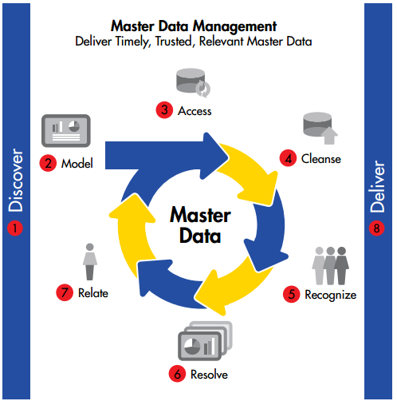
Master Data Management
Creating the Master File
Standardizing Site Data
Identical Name
Identical Location
Master Record
From Informatica Master Data Management Brochure

Slide 4

mdmR
StreetSweepR
Linguistic Grouper
CollectR
NEA_assembler
ConcatAssembleR
SiteScrubR
GeoCodeR
LineageR
RectifyR
GeoNameAlyzeR
GeoMatrixR
BulkPackageR

Slide 5
Review the Challenge
Site Names
Site Location

Slide 6
Review the Challenge
Site Names
Vary between:
Times
Branding
Ownership
People
Language
Local
International Standard
Intent
Function
Drug delivery
Clinical Setting
Administrative Center
Site Location
Position on surface of Earth

Slide 7
Rethink the Challenge
Site Names
Vary between:
Times
Branding
Ownership
People
Language
Local
International Standard
Intent
Function
Drug delivery
Clinical Setting
Administrative Center
Site Location
Position on surface of Earth

Slide 8

Rethink the Challenge
Site Names
Vary between:
Times
Branding
Ownership
People
Language
Local
International Standard
Intent
Function
Drug delivery
Clinical Setting
Administrative Center
Site Location
Objective
Verify Correct Address
Quantitatively Define Location
Address Doctor or Smarty Streets
Google Maps!
& ggmap package

Slide 9
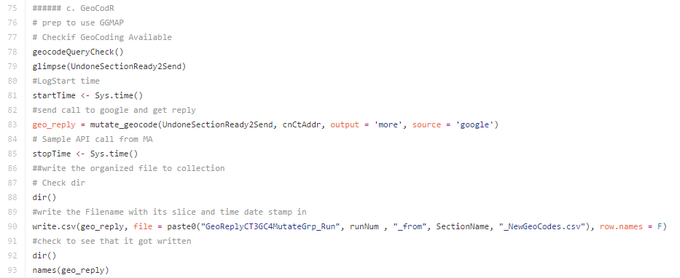
library(ggmap)

Slide 10
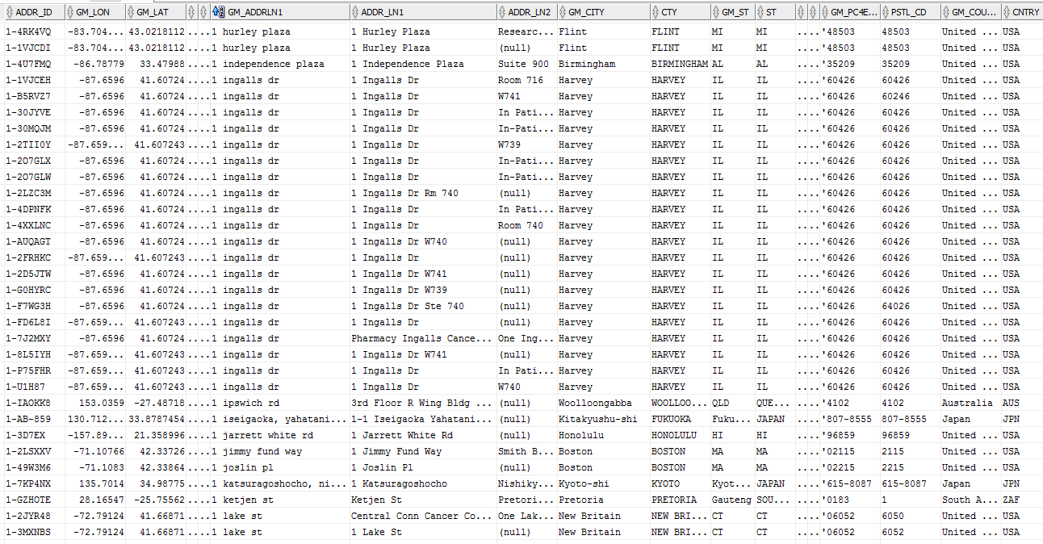
Verified Addresses (Thank you ggmap package!)

Slide 11
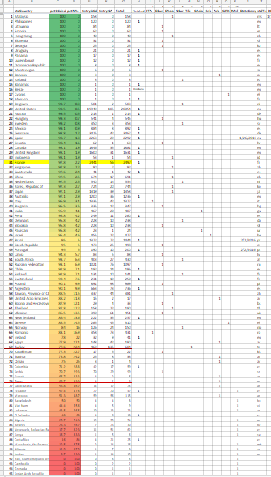
Evaluating GeoCode Results
Address return rate and
precision is variable
Analyze weakest areas
Group into linguistic clusters
Target greatest impacts first

Slide 12
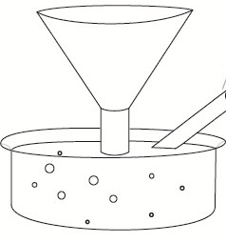
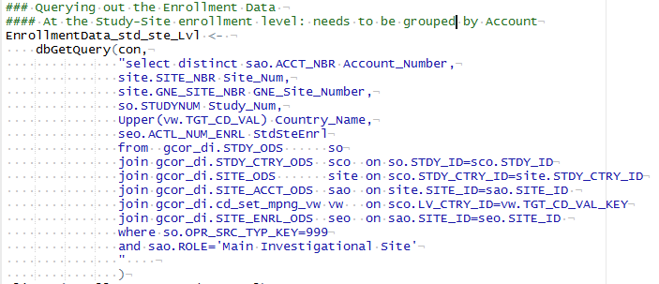
Collect the Data – SQL into R
Bring the data in to a manipulation friendly environment.
Stir it around,
take samples
perform assays

Slide 13

Spurring on the GeoCodeR
2500 query limit per day per IP address
Build modules, practice GitHub, bring in more laptops, wrangle back together (or now, Glob), add in more Raspberry PI’s?

Slide 14

Improving the GeoCodeR Results
Improve the address data fed into the GeoCoder

Slide 15
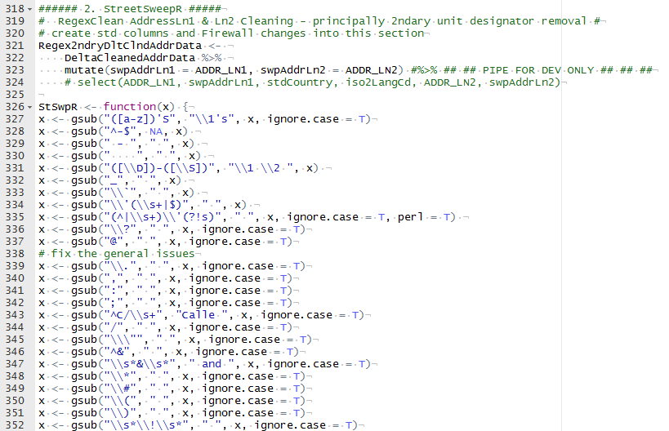
Improve the Street Address Data
StSwpR()
Cleanse & Standardize address data

Slide 16
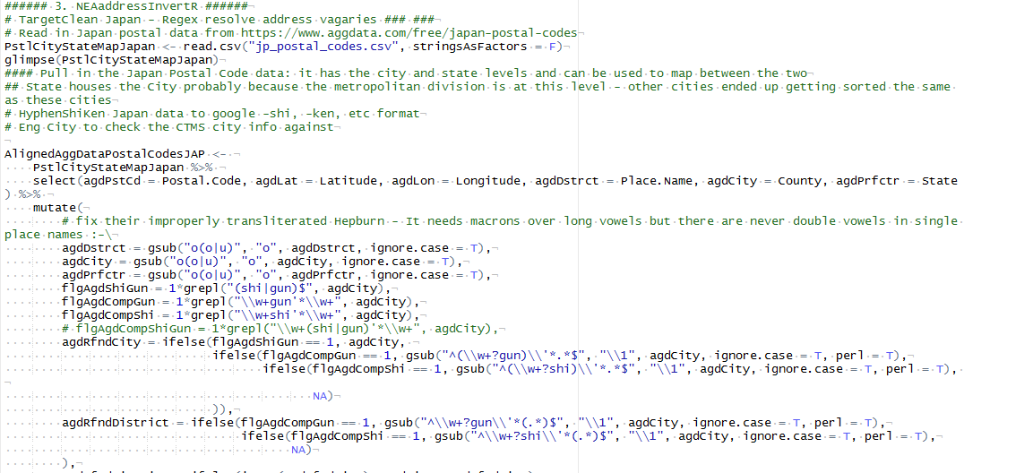
Improving the GeoCodeR
NEA_assembler

Slide 17
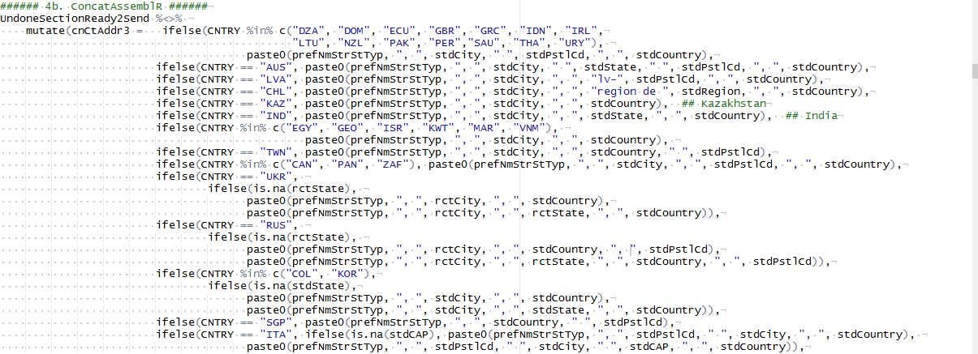
Improving the GeoCode Results
ConcatAssembleR
Resculpt concatenation formats

Slide 18
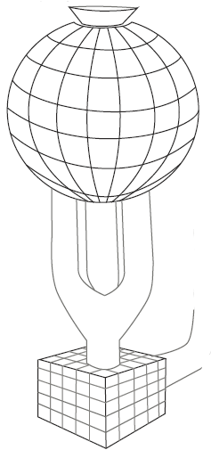
Best of the GeoCode Results
LineageR
Tracking data origins
GeoRectifyR
Selecting most precise & similar addresses (by String Distances)

Slide 19
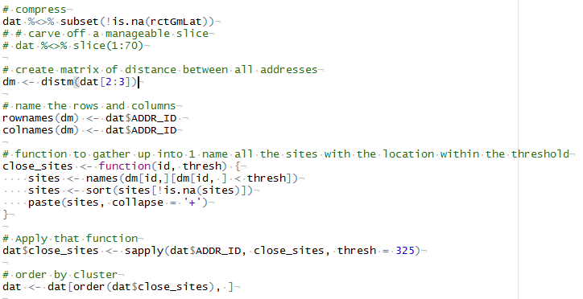
Generating GeoClusters
GeoMatrixR
• Calculating Distances between the geo-coordinates of all the addresses
• Collecting all ID’s within a threshold distance

Slide 20
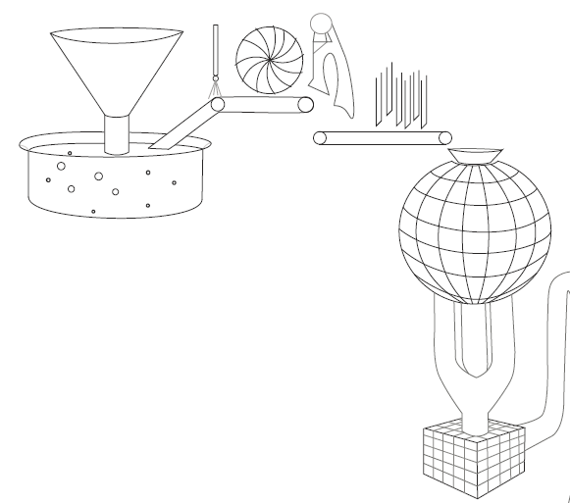
GeoGraphic Clusters Achieved
Site Location
Clusters of all addresses within 325 meters
Site Names
Vary
Over Time
Between people
By Function

Slide 21
mdmR
StreetSweepR
Linguistic Grouper
CollectR
NEA_assembler
ConcatAssembleR
SiteScrubR
GeoCodeR
LineageR
RectifyR
GeoNameAlyzeR
GeoMatrixR
BulkPackageR

Slide 22
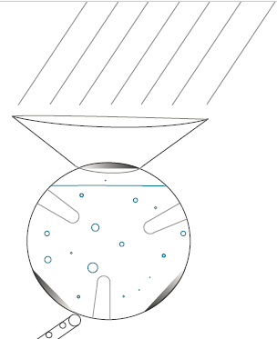
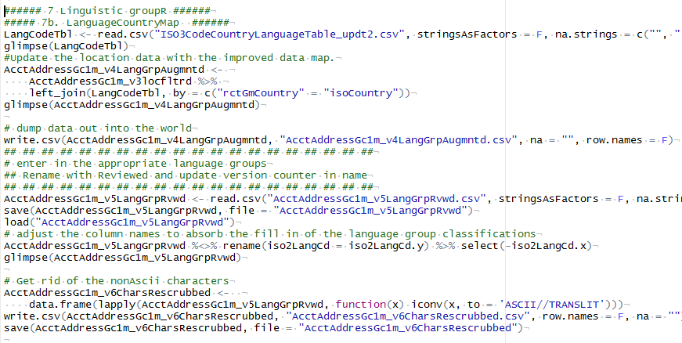
Linguistic Grouper
Dividing the world (and the data) up by linguistic regions
DEUtsche
ENGlish
ESPanol/FRAncais
PORtuguese
ITAlian
REM2

Slide 23
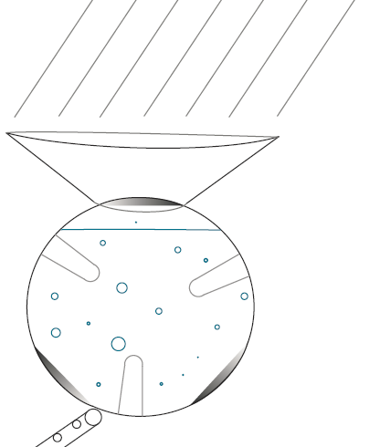
SiteScrubR
Regex Cleansing of SiteNames
Expand Abbreviations
Standardize Terms
Standardize Formats
Mend Fractures
Decode Acronyms
Remove Extraneous information

Slide 24
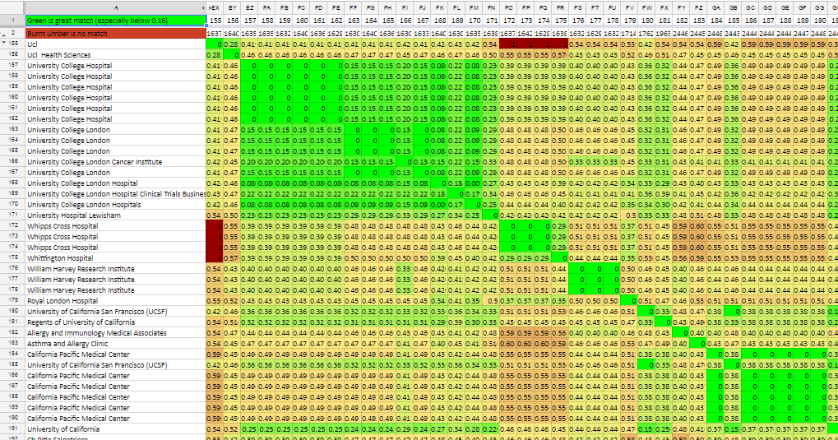
Review Results
What the computer sees in determining similarity of words

Slide 25
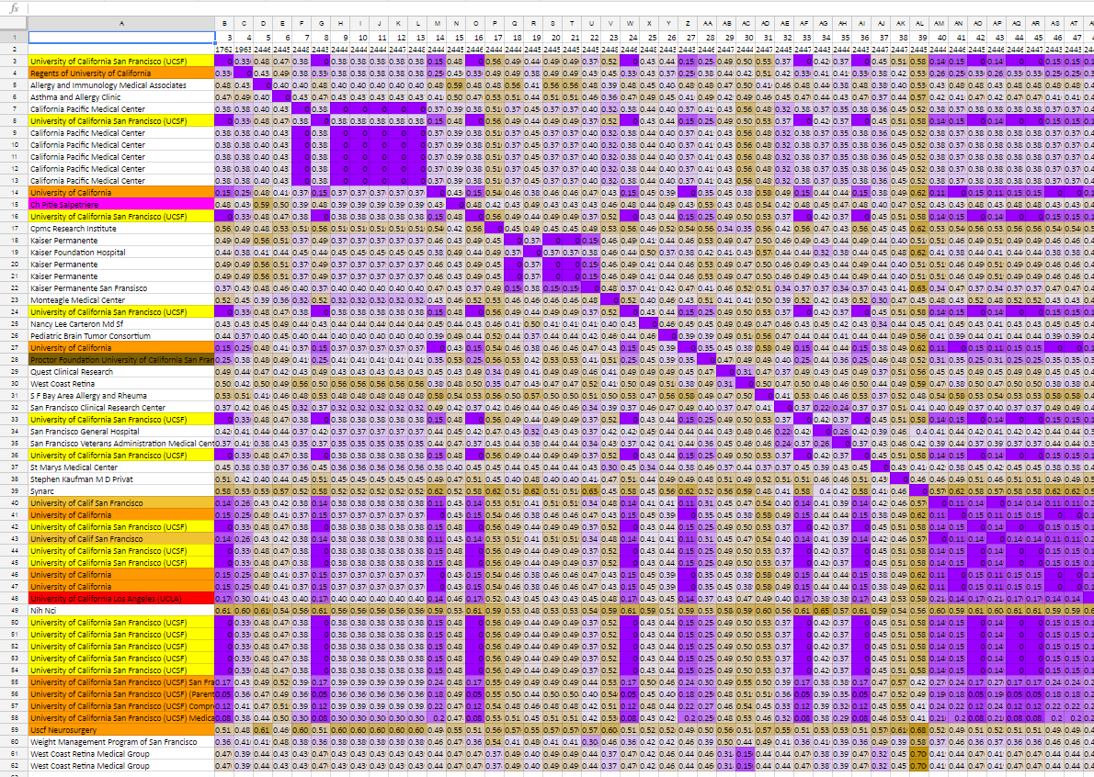
Review Results
What the computer sees in determining specificity of words

Slide 26
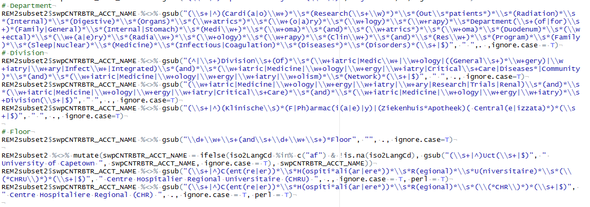
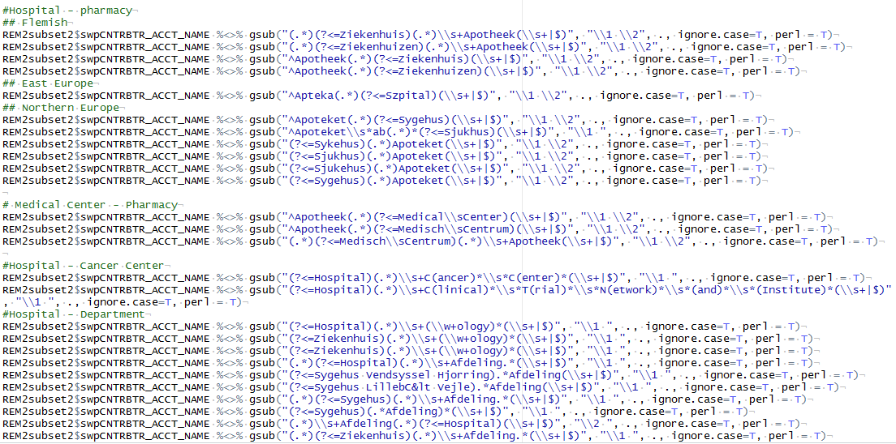
SiteName ScrubR

Slide 27

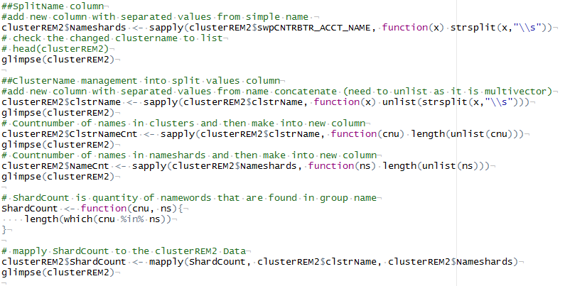
GeoNameAlyzer
Comparing Names of individuals to those in their GeoCluster
Selecting the most fitting SiteName

Slide 28
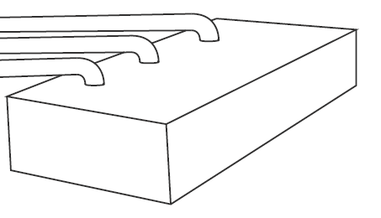
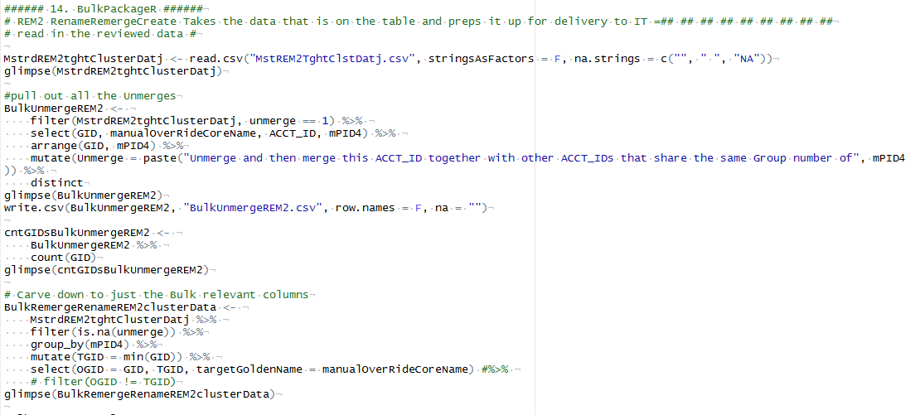
Bulk PackageR
Bulk Rename
Bulk Unmerge
Bulk Remerge

Slide 29
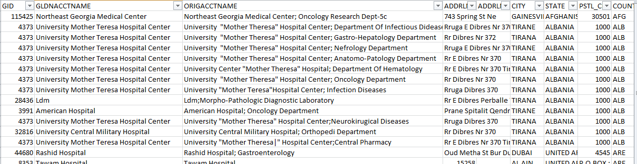
Results

Slide 30
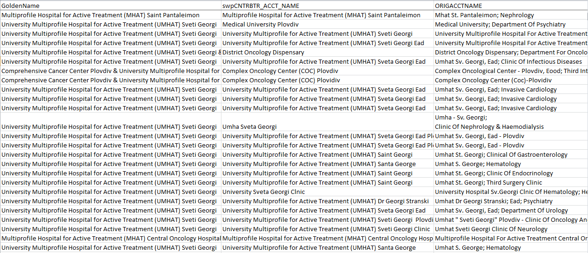
Name Transform Results – Sveti Georgi

Slide 31
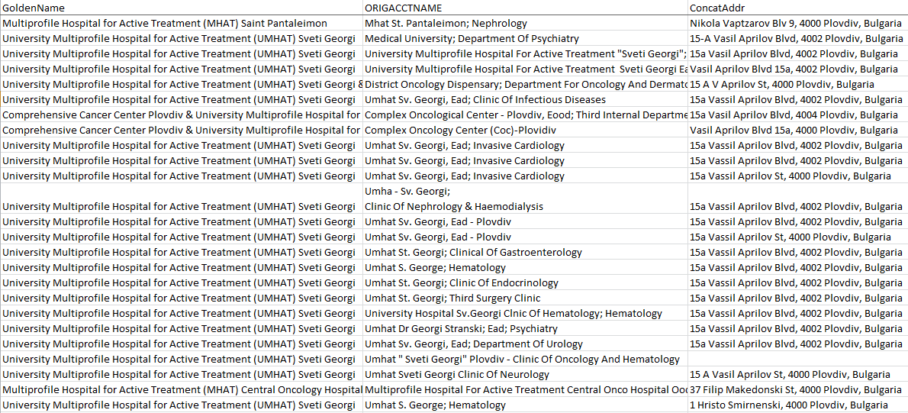
Simple Results – Sveti Georgi

Slide 32
Final Compression Results
Initial Count: 212,659
Final Count: 23,494
Compression Ratio of 9.1x

Slide 33
mdmR
StreetSweepR
Linguistic Grouper
CollectR
NEA_assembler
ConcatAssembleR
SiteScrubR
GeoCodeR
LineageR
RectifyR
GeoNameAlyzeR
GeoMatrixR
BulkPackageR

Slide 34
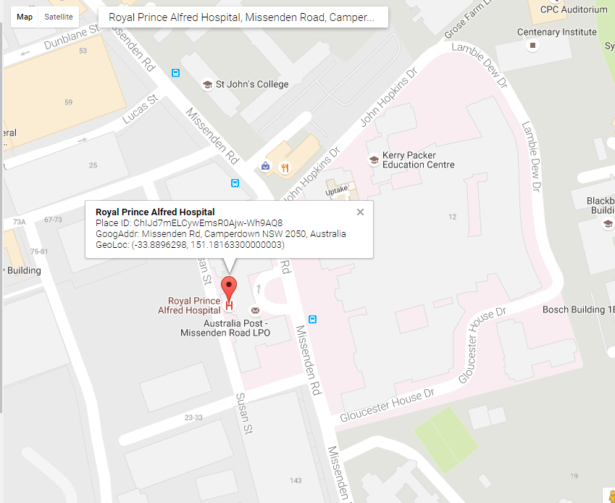
The Next Steps
Google PlaceID’s
Tie data to Global Source System of Record
Google Maps Internal Key
Place_ID

